Slide 1
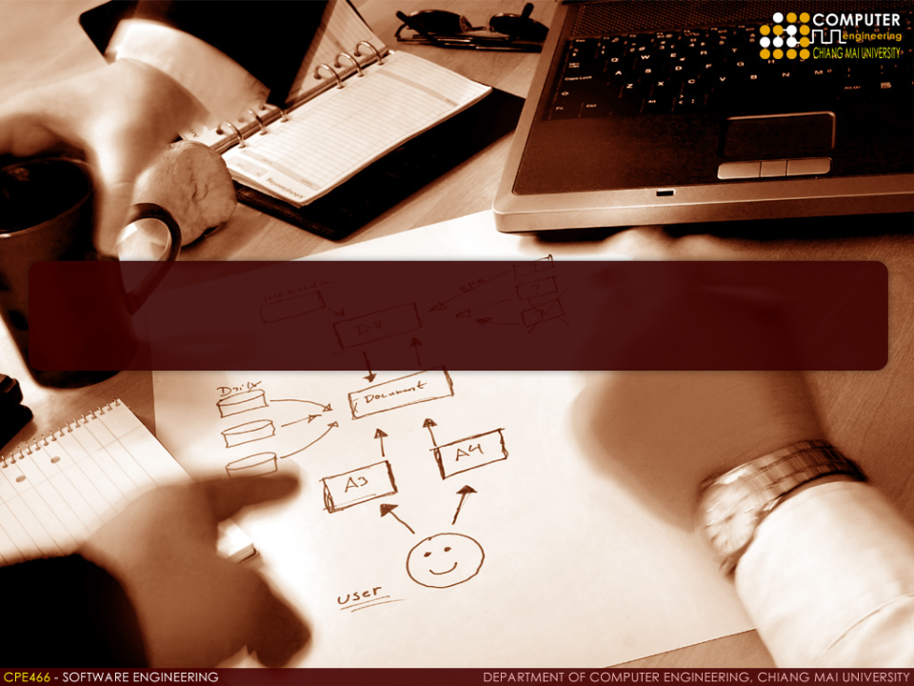
LECTURE 1 Introduction to Software Engineering

Slide 2
Definitions

Slide 3
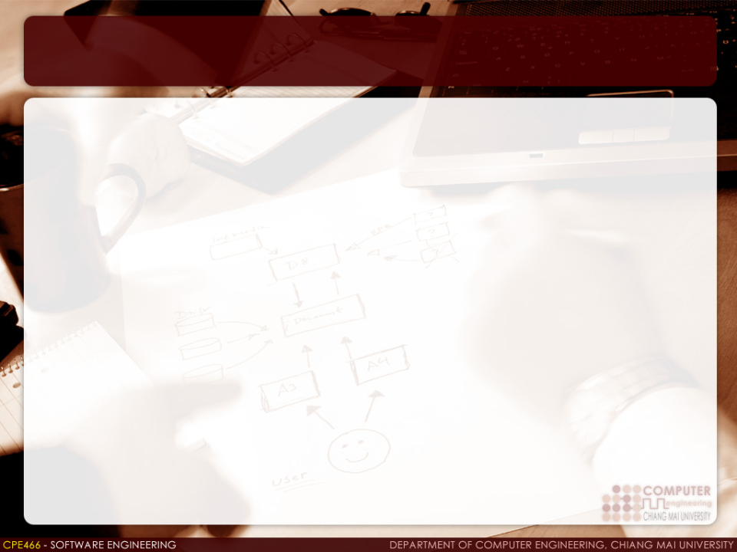
Software Engineering
The application of a systematic, disciplined, quantifiable approach to development, operation, and maintenance of software; that is, the application of engineering to software (IEEE, 1990)
Software engineering is an engineering discipline that is concerned with all aspects of software production from the early stage of system specification to maintaining the system after it has gone into use. (Ian Sommerville, 2007)
A discipline whose aim is the production of quality software, delivered on time, within budget, and satisfying users' needs. (Stephen R. Schach, 1993)

Slide 4
System Engineering
An interdisciplinary collaborative approach to derive, evolve, and verify a life cycle balanced system solution that satisfies customer expectations and meets public acceptability (IEEE, 1984)
Software engineering is a part of it.

Slide 5
Problems
Costs
Complexity
New technologies
User expectations
Improvement

Slide 6
Software Engineering Errors: A Survey
According to Prof. Thomas Huckle from Institut für Informatik in Germany
INTEL: no more than 80-90 Bugs in Pentium.
Standard Software: 25 bugs per 1000 lines of program.
Good Software: 2 errors per 1,000 lines.
Space Shuttle Software: < 1 errors per 10,000 lines.
Cellular Phone: 200,000 lines of program, up to 600
errors.
Windows95: 10 million lines, up to 200 000 errors.
softwares are all buggy ?

Slide 7

Software Engineering Failures: A Survey
Ariane 5 Rocket Explodes
Approximate loss: $370 million
Lesson learned:
Reuse of anything can be dangerous. The changes and their consequences must be fully analyzed before implementing reuse.
Test cases must be developed for real environment.
Software systems must be robust to errors and exceptions.

Slide 8
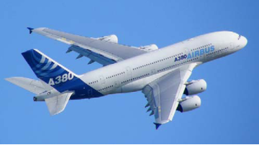
Software Engineering Failures: A Survey
Airbus 380 Delivery Delays
Approximate loss: 4.8 billion euros.
Two CEOs of Airbus resigned.
Lesson learned:
Standardize of software tools is important.
Loss in communication can cause tremendous loss in time and money.

Slide 9
What is Software?
Computer programs and associated documentation such as requirements, design models, configuration files, and user manuals
Software products may be
Generic - developed to be sold to a range of different customers e.g. PC software such as Excel or Word.
Bespoke (Custom) - developed for a single customer according to their specification.

Slide 10
Software Types
Types of software products
Single application
Suite of application
Business software products
Consumer software products
Software as a service

Slide 11
Roles of Software
“Software is both a product and a vehicle for delivering a product”
Pressman (2001)

Slide 12
What are the Attributes of Good Software?
The software should deliver the required functionality and performance to the user and should be maintainable, dependable and acceptable.
Maintainability
Software must evolve to meet changing needs
Dependability
Software must be trustworthy
Efficiency
Software should not make wasteful use of system resources
Acceptability
Software must accepted by the users for which it was designed. This means it must be understandable, usable and compatible with other systems.

Slide 13
What do you need to build a software product?
Software development process
Software development methods
Software engineering standards
Software engineering tools (CASE)
More importantly, you need good People and good Management.

Slide 14
What is A Software Process?
A set of activities whose goal is the development or evolution of software.
Generic activities in all software processes are:
Definition - what the system should do and its development constraints
Development - production and testing of the software system
Support – maintenance and changing the software in response to changing demands.

Slide 15
Software Development Terminologies
Methodology (or method)
A specific collection of principles/practices
Framework
An outline that requires customization
Model
A description that can be implemented using any method/framework

Slide 16
Software Engineering Standards
Professional standards
e.g. IEEE 12207
International standards
e.g. ISO 25000 (Quality), IEC 15504 (SPICE)
Industry standards
e.g. XML, UML, CMMI

Slide 17
What is CASE Tools?
Computer Aided Software Engineering
Any computer-based tool for software definition, development, and support
Structured Analysis (SA)
Structured Design (SD)
Editors, Compilers and Debuggers
Code Generators
Documentation Generators
Project Management
Scheduling and Tracking
Upper-CASE
Tools to support the early process activities of requirements and design
Lower-CASE
Tools to support later activities such as programming, debugging and testing

Slide 18
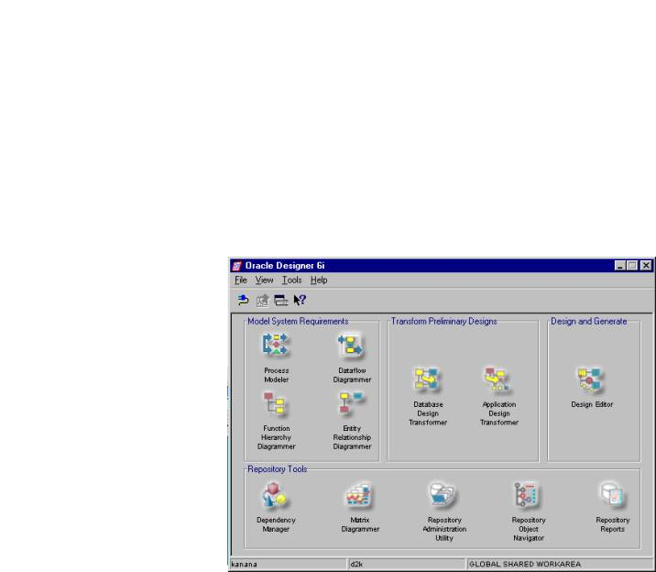
CASE Tools: Examples
ORACLE Designer
Design and generate an information system

Slide 19
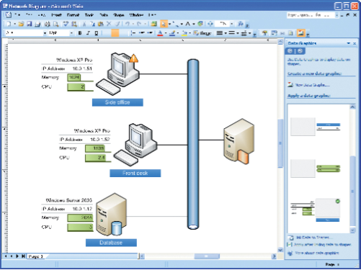
CASE Tools: Examples
Microsoft Visio
Diagramming

Slide 20
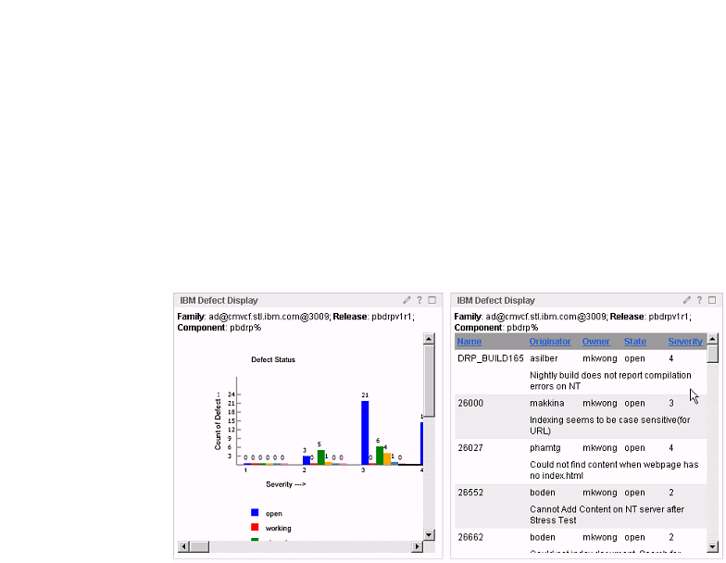
CASE Tools: Examples
IBM Rational ClearCase
Revision control of source code and SD assets

Slide 21
People in Software Engineering
People is considered the most important part of software engineering.
Project mangement
People CMM
A maturity framework for managing and developing the workforce of an organization

Slide 22
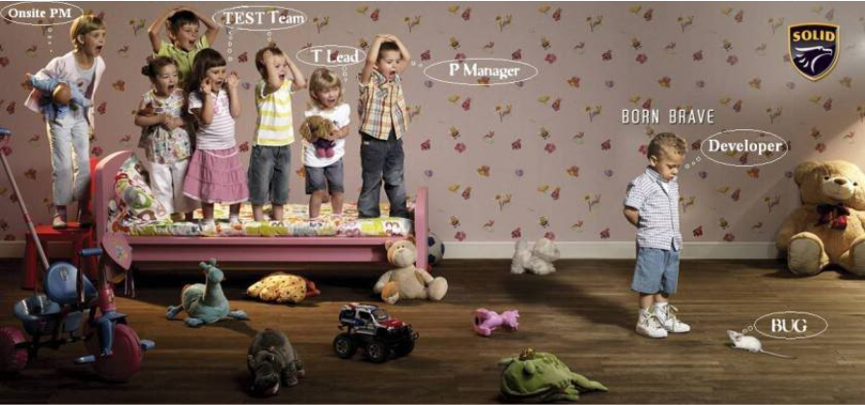
Management

Slide 23
Project Management
Cost estimation
Budget
Time
Staffing
Quality assurance
Measurement and metrics
Process improvement

Slide 24
Software Engineering

Slide 25
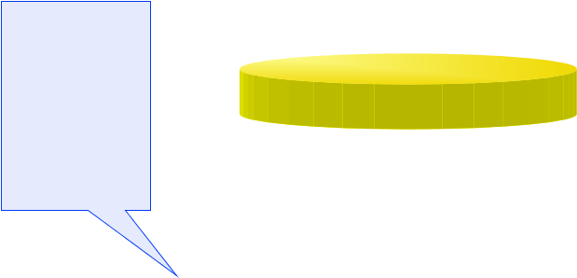




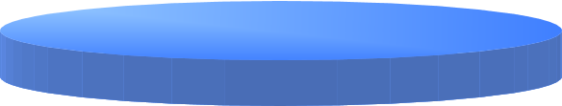

Software Engineering Layers
A “Quality” Focus
Continuous process improvement
Concept Development
Tools
Automated or semi-automated support for the process and the methods
CASE (Computer Aided System Engineering)
Tools
Methods
Process Model
A “Quality” Focus
Process Model
Framework Design
Key Process Areas (KPAs)
Project Management
Planning
Milestones
Quality Assurance
Method
Technical Activities
Requirements Analysis
Programming
Testing
Support

Slide 26
A Generic View of SE
Engineering is analysis, design, construction, verification, and management of technical (or social) entities.
Entity → computer software
A software engineering process must be defined:
Definition phase
Development phase
Support phase

Slide 27






Software Engineering Phases
Definition
Phase
Development
Phase
Support
Phase
What?
What information is to be processed?
What function and performance are desired?
What system behavior can be expected?
Identify key requirements - Interface, design constraints, validation criteria
How?
How data are to be constructed?
How function is to be implemented within a software architecture?
Procedural details, interfaces, design, programming, testing
Change?
Focuses on “change” associated with error correction, adaptations, changes.
Correction, Adaptation, Enhancement and Prevention (Reengineering)

Slide 28










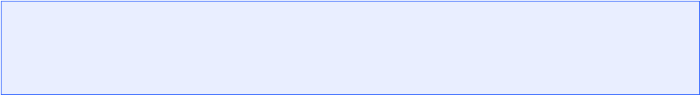

Software Engineering Process
Requirement Definition
Design
System Design
Sub-system Development
System Integration
System Installation
Development
System Evolution
System Decommissioning
Support

Slide 29
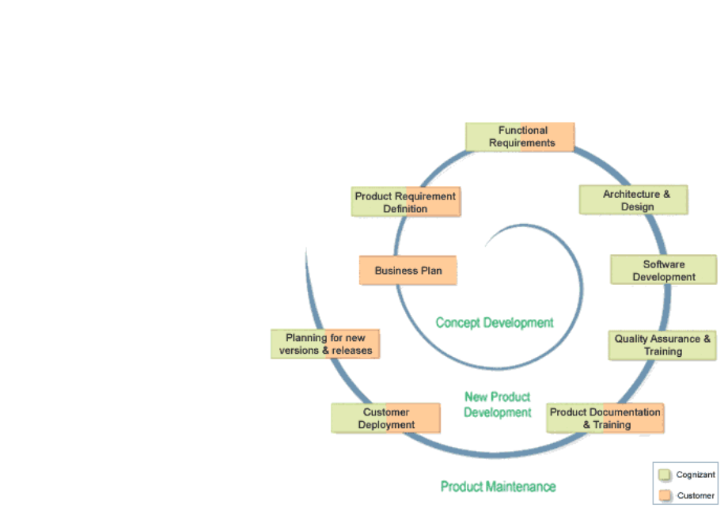
SE Phases Example
Product life cycle from Cogzinant Technology Solution (http://www.cognizant.com/industries/telecom/telecom_sv.htm)

Slide 30
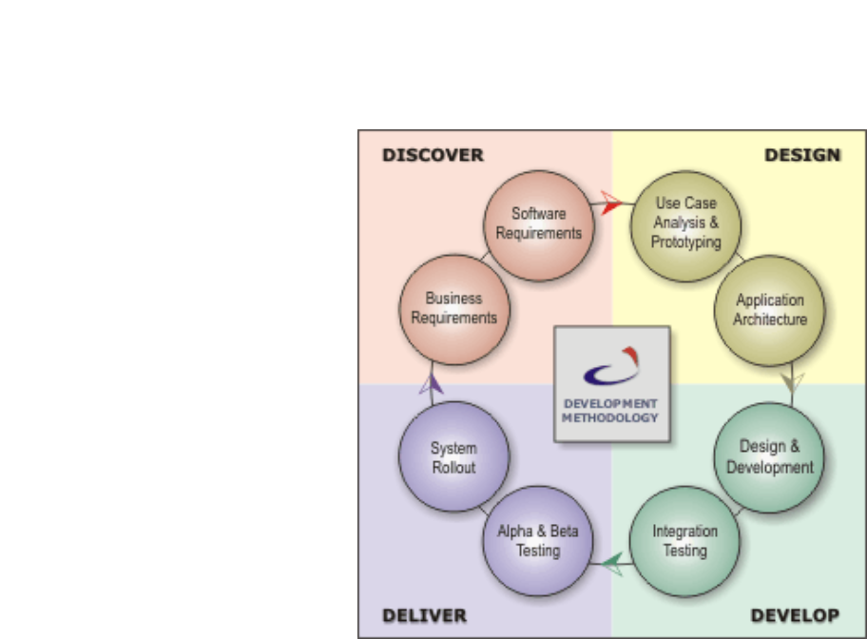
SE Phases Example
Product life cycle from Diyatech (http://www.diyatech.com/devmetho.htm)

Slide 31
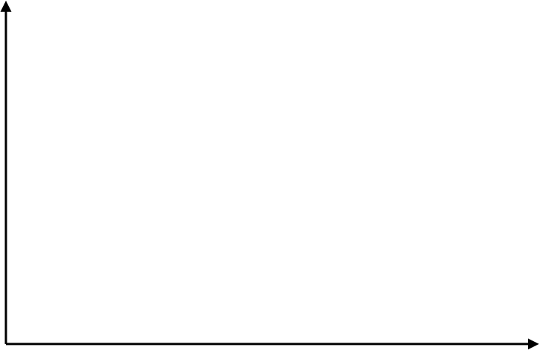
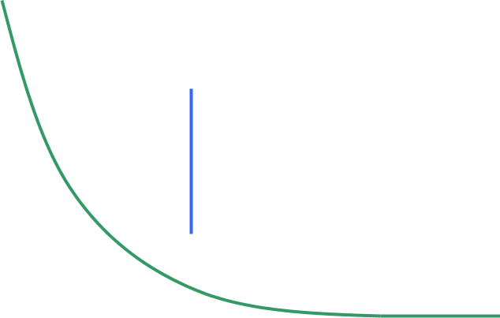







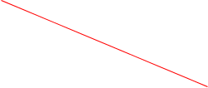


Software Life Cycle
Failure
Rate
Increased failure rate
due to side effects
Change
Actual Curve
Idealized Curve
Time

Slide 32





The Cost of Change
60-100x
1.5-6x
1x
Definition
Development
Support
(After released)

Slide 33
Software Challenge
How do we ensure the quality of software we produce?
How do we meet growing demand and still maintain budget control?
How do we upgrade aging software?
How do we avoid disastrous time delay?
How do we successfully institute new software technologies?

Slide 34
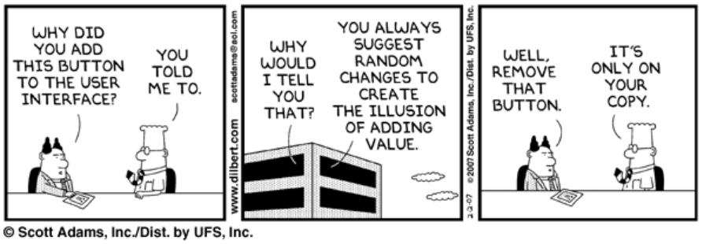
Software Challenge

Slide 35
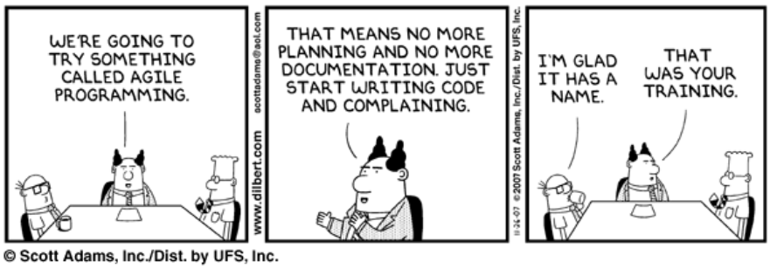
Software Challenge

Slide 36
Summary

Slide 37
Summary
Software engineering is a process of developing software
Software life cycle
Design
Development
Support

